Slide 1
08 Dec 2022 Picked from Port 001
TCLU8503790
Cargo Arrival Notice Date
01 Jan 2023
Delivery Appointment
04 Jan 2023
Last Free Day at Port
12 Jan 2023
Date | Moves | Location | Vessel & Voyage | Truck No
1O Dec 2022 Departure NHAVASHEVA,INDIA MAERSK DENVER-935W --
18 Dec 2022 Departure HONGKONG,HONGKONG TEST001 --
Departure COLOMBO,SRILANKA TEST002 --
Arrival NORTH CHARLESTION , SO TEST002 --
06 Jan 2023 Customs Entry Filed --- -- --
08 Jan 2023 Customs Clearance Completed
15 Dec 2022 Reached Warehouse 001
21 Dec 2022 Left Warehouse 001
14 Dec 2022 Empty Returned 001

Slide 2
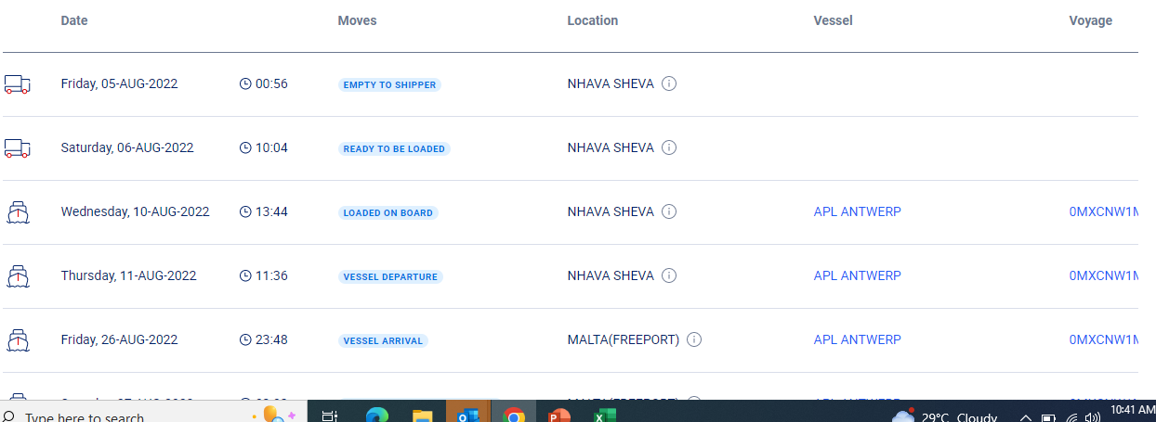
SAMPLE

Slide 3


Reach out to us
Mr. Krishnakumar
krishnakumar@odaksolutions.com
+91 95002 66635
Mr. Agilavasu
agilavasu@odaksolutions.com
+91 95000 00755
Please visit us at
www.odaksolutions.com

